Slide 1
Fundamental Programming Structures in JAVA
Interface

Slide 2
Objectives
To understand the concept of Java interfaces.
To outline the benefits of using interfaces.
To define a Java interface.
To learn how to use Java interfaces.

Slide 3
Interface
An interface in Java is a blueprint of a class. It has static constants and abstract methods.
The interface in Java is a mechanism to achieve abstraction. There can be only abstract methods in the Java interface, not method body.
In other words, you can say that interfaces can have abstract methods and variables. It cannot have a method body.

Slide 4
Interface
An interface is a programming construct in Java that defines a contract (a set of behaviours) that classes must follow.
An interface defines a set of abstract methods (methods without bodies) that must be provided by any class that implements the interface.
In result, Interfaces allow you to create a contract that ensures all implementing classes use the same method signatures.

Slide 5
Benefits of Interface
The intent of the interface is to specify a common behavior for objects.
Interfaces provide a powerful tool for accomplishing Abstraction, multiple Inheritance and Polymorphism.
Interfaces are also used to provide code reusability and support good software engineering practises.

Slide 6
How to use Java interfaces?
An interface is treated like a special class in Java.
Each interface is compiled into a separate bytecode file, just like a regular class.
Like an abstract class, you cannot create an instance from an interface using the new operator, but in most cases you can use an interface more or less the same way you use an abstract class.
For example, you can use an interface as a data type for a variable, as the result of casting, and so on.

Slide 7
Define a Java interfaces
An interface are class-like structures that contain only constant data fields and abstract methods.
Interface contains:
only abstract methods (without adding the “abstract” keyword).
Static final fields
no need to constructors too.
A class that derives from an interface must implement all members of the interface.
To denote that the subclass inherits an interface, (implements) keyword should be used.

Slide 8
Interface Template
Interface name
List of Attributes……..
Method₁ name (): return data type or void ;
Method₂ name (): return data type or void ;
.
.
Class Name
List of Attributes …..
Method _{n} name (): return data type or void ;
A class
Template
symbols used in class design
Method₁ name (): return data type or void
Method₂ name (): return data type or void
Method₃ name (): return data type or void
Class
.
.
.
Interface
Method₃ name (): return data type or void

Slide 9
Interface Template
Regardless of whether a programmer specifically writes a static final, any data field added to an interface will be regarded as a static final; therefore, the value of these data fields should be provided directly in the declaration statement.
Interface name
List of Attributes……..
Method₁ name (): return data type or void ;
Method₂ name (): return data type or void ;
.
.
The special thing about the abstract class is that it has only abstract methods (either with or without adding the “abstract” keyword at the implementation phase) by adding a semicolon at the end of each method declaration during the design stage.
Method_{n} name (): return data type or void ;
Interface 1
Super
Class
Interface 2
Remember that a subclass can extends only one concrete class or an abstract class, but it can implements any number of interfaces..
Sub
Class

Slide 10
Interfaces Example
Example: Going back to the company that has two types of employees, the first type gets a monthly salary (SEmp), and the other gets an hourly-based salary (HEmp). This company also employs (Trainees) who work for experience only and receive no pay from the employer.

Slide 11
Interfaces Example (Design Phase)
Emp
+ name: String
+ job: String
+ startYear: int
Company
+ calYearServices (int currentYear): int
+ toString(): String
+ Wsal(): double;
extends
implements
Trainee
hours : int
HEmp
hours : int
rate: double
SEmp
MSal: int
+ toString(): String
+ toString(): String
+ toString(): String

Slide 12
Interfaces Example
When interface is preferable solution?
When this method is applicable to some subclasses, and no need to add this method to the super class.
When the method is shared between many classes but they can’t be subclass from a specific class ( no sense).
For example, there is a method that calculates the employee's monthly salary called wsal(). If you put it in the superclass (Emp), then the company must pay salaries to all employees, including SEmp, HEmp, and Trainees. However, Trainees do not receive a salary; they only work for experience. Because of this, it is better to shift wsal() from the superclass to the interface and let SEmp and HEmp implement that interface, and both SEmp and HEmp should redefine (override) it in a way that suits them.

Slide 13
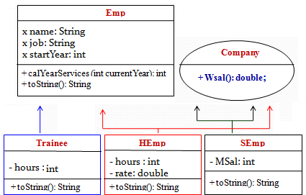
Interfaces Example (Design Phase)
Note that the Company interface contains an abstract method (Wsal()).
(Wsal()) is an abstract method that has only signature and without body.
subclasses (SEmp and HEmp) must override the abstract methods (Wsal()). Otherwise, compile-time errors will appear in all the subclasses that implement from the interface.
Logically, it is not allowed for the Trainees subclass to override the Wsal() method.

Slide 14
Interfaces Syntax
To declare an Interfce, we use the access modifier first, then the “interface" keyword, and the interface name:
access_modifier interface interface_Name{ }
To declare a data field, we use the access modifier first, then either with or without adding the final static, the data type, and the variable name, and finally give the value of the data field directly in the declaration statement.
access_modifier final static data type variableName = value ;

Slide 15
Interfaces Syntax
To declare an abstract method, we use the access modifier first, then either with or without adding the “abstract” keyword, the return type, the method name, and finally a semicolon at the end of the method definition.
access_modifier abstract return_type methodName (parameter_list);

Slide 16
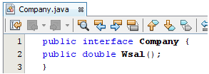
Interfaces Example implementation phase
Interface name
Company
+ Wsal(): double;
This class should be saved
as (Company.java).
Implementation (programming) Phase using java
interface in Java is to achieve 100% abstraction by hiding the actual implementation from the user

Slide 17
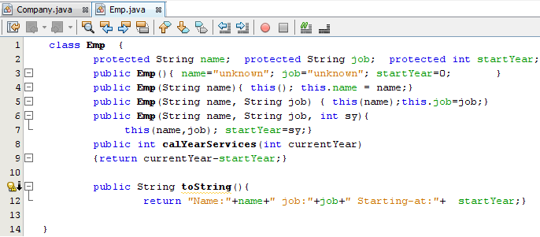
Interfaces Example implementation phase

Slide 18
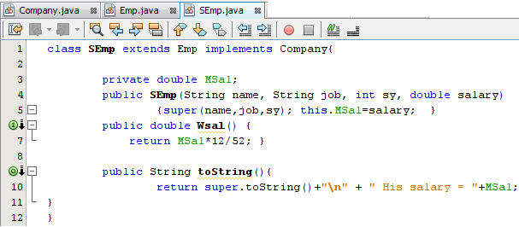
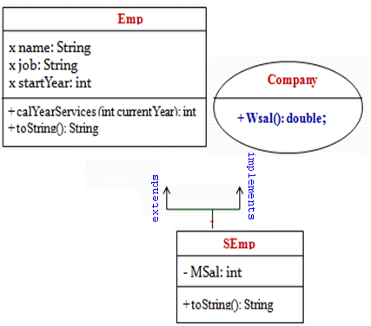
Interfaces Example implementation phase

Slide 19
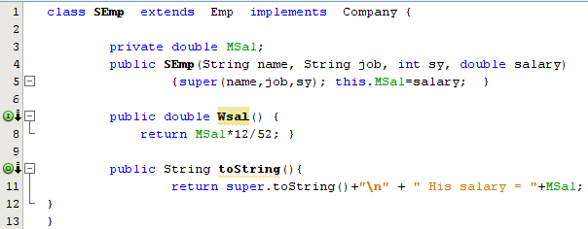
Interfaces Example implementation phase
SEmp overrides the abstract methods (Wsal()) to add the missing part (the body of the method), which is its own method for calculating the employee's monthly salary.

Slide 20
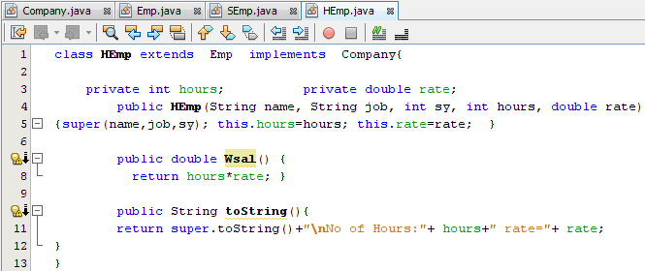
Interfaces Example implementation phase

Slide 21
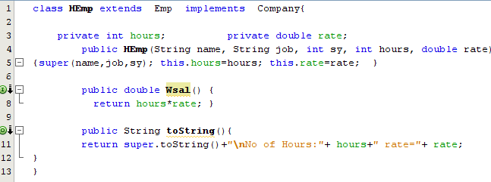
Interfaces Example implementation phase
HEmp overrides the abstract methods (Wsal()) to add the missing part (the body of the method), which is its own method for calculating the employee's hourly salary.

Slide 22
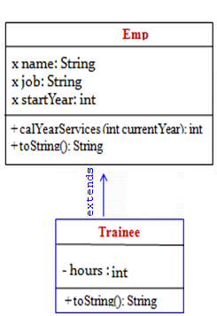
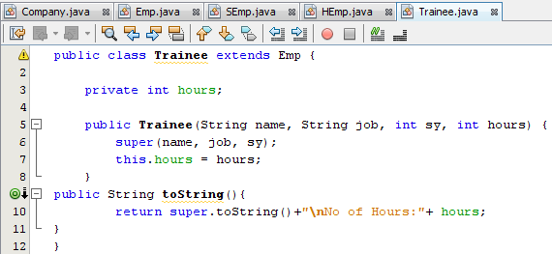
Interfaces Example implementation phase

Slide 23
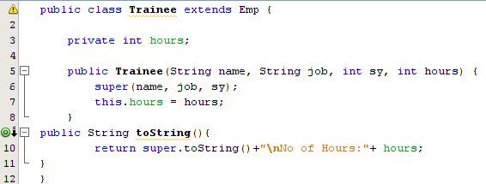
Interfaces Example implementation phase
Logically, it is not allowed for the Trainee subclass to override the Wsal() method. But what if wsal() is defined in the trainee subclass? In this case, no error will appear at compile-time, and the wsal() method that will be defined in the Ttrainee subclass will be considered a new method, not an overridden method.

Slide 24
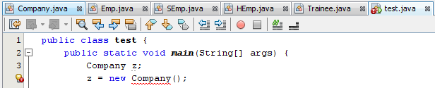

Interfaces Example implementation phase
Note that the Company interface cannot be instantiated (i.e., created as an object) directly as shown in line 4, but we can define a pointer as shown in line 3; look at the following figure to read the error.

Slide 25
How to implement multiple interfaces in java?
Simple Example: In the following, we create two interfaces (the first one is named "Person" and the second one is named "Employee") and a class named "InterfaceExamples“.
The "InterfaceExamples" class implements the interface "Person" and the interface "Employee“:
Person
Employee
person_age: int
person_name: String
+ EmployeeInfo (String name) : void ;
+ personInfo(): void ;
Interface Examples

Slide 26

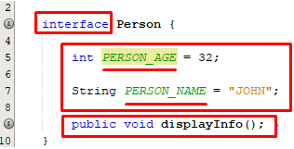
How to implement multiple interfaces in java?
Person
Employee
person_age: int
person_name: String
+ EmployeeInfo (String name) : void ;
+ personInfo(): void ;
Constant Fields
Method Declaration
Method Declaration
The employee interface declares a method called "EmployeeInfo()", which takes a parameter.
The Person interface declares two constants Fields and a method called "PersonInfo() “.

Slide 27
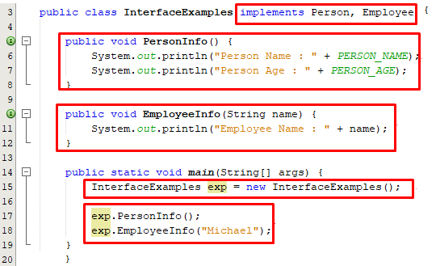
How to implement multiple interfaces in java?
The below-given screenshot provides the complete code along with the output:
Class implements Multiple Interfaces
Method Definition of Person Interface
Method Definition of Employee Interface
Object creation
Method Calling with object of class

Slide 28
Omitting Modifiers in Interfaces
All data fields are public final static and all methods are public abstract in an interface. For this reason, these modifiers can be omitted, as shown below:
A constant defined in an interface can be accessed using syntax InterfaceName.CONSTANT_NAME (e.g., T1.K).

Slide 29
Abstract Class Vs Interface
The following table shows a comparison between interface and abstract class.
Abstract class | Interface
Abstract class …. { } | Interface ….. { }
May contain abstract method | All methods are abstract without saying that
extends | implements
All type fields | Static final fields
Can not be instantiated
All sub classes must override all abstract method

Slide 30
References
[1] Introduction to Java Programming, Comprehensive Version, Student Value Edition, Daniel Liang, 12th Edition, Pearson 2019
lecture Notes :edugate.asu.edu.jo.
lecture Videos : YouTube channel.
Lab manual

